Slide 1
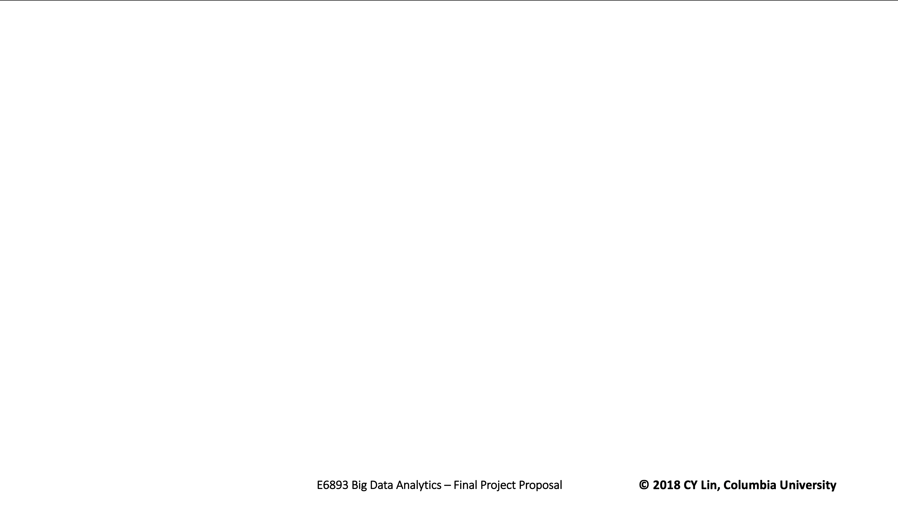

E6893 Big Data Analytics:
Genome Splicing 201812-45
Team Members (with UNI):
Yu, Chenghao (cy2475)
Zeng, Yuwei (yz3302)
Zhou, Zhibo (zz2520)

Slide 2
CONTENTS
Abstract
Pipeline and Platform
Algorithm and Key issue
Accomplish and future work
what
Why
Pipeline
Platform
Algorithm
Key issue
Accomplish
future work

Slide 3
0 1
Abstract
PART ONE

Slide 4

Abstract
Pipeline and Platform
Algorithm and Key issue
Accomplish and future work
what
What ‘s the environment
Appearance of NGS(next-generation sequencing)
Using capillary electrophoresis-based Sanger sequencing, the Human Genome Project took over 10 years and cost nearly $3 billion.
Next-generation sequencing, in contrast, makes large-scale whole-genome sequencing (WGS) accessible and practical for the average researcher. It enables scientists to analyze the entire human genome in a single sequencing experiment, or sequence thousands to tens of thousands of genomes in one year.(1000 genomes PROJECT)

Slide 5
Abstract
Pipeline and Platform
Algorithm and Key issue
Accomplish and future work
why
1
2
3
Analyze epigenetic factors such as genome-wide DNA methylation and DNA-protein interactions
Rapidly sequence whole genomes
Zoom in to deeply sequence target regions

Slide 6
0 2
Pipeline and Platform
PART TWO

Slide 7
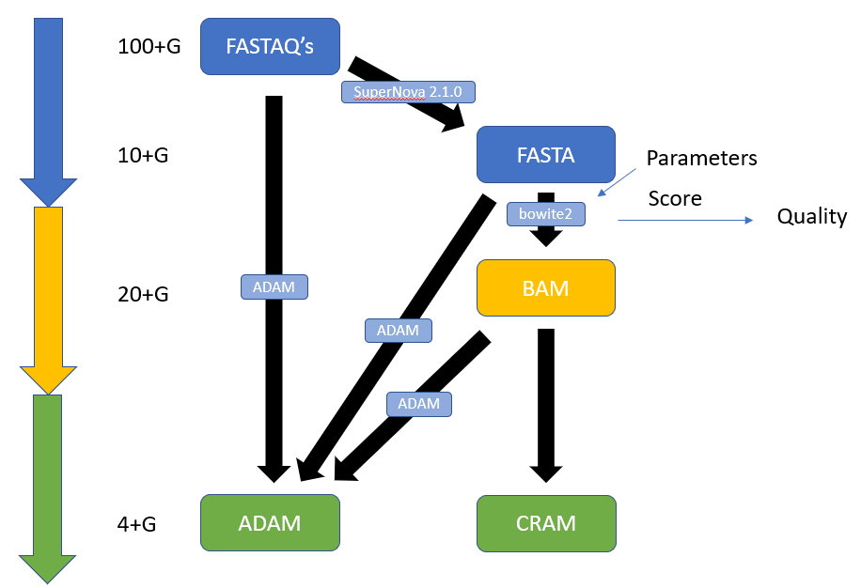
Abstract
Pipeline and Platform
Algorithm and Key issue
Accomplish and future work
pipeline

Slide 8
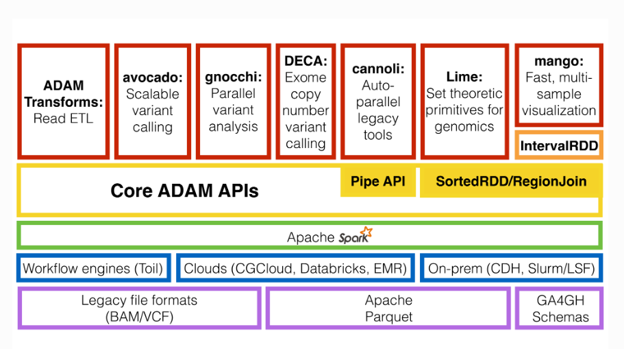
Abstract
Pipeline and Platform
Algorithm and Key issue
Accomplish and future work
platform

Slide 9
0 3
Algorithm and Key issue
PART THREE

Slide 10
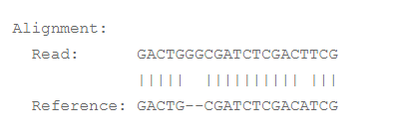
Abstract
Pipeline and Platform
Algorithm and Key issue
Accomplish and future work
Algorithm
End-to-end alignment
The following is an “end-to-end” alignment because it involves all the characters in the read.
Read: GACTGGGCGATCTCGACTTCG
Reference: GACTGCGATCTCGACATCG
Notes:
Bowtie 2 performs end-to-end read alignment. That is, it searches for alignments involving all of the read characters. This is also called an “untrimmed” or “unclipped” alignment.

Slide 11
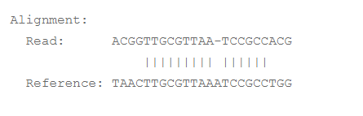
Abstract
Pipeline and Platform
Algorithm and Key issue
Accomplish and future work
Algorithm
Local alignment example
The following is a “local” alignment because some of the characters at the ends of the read do not participate
Read: ACGGTTGCGTTAATCCGCCACG
Reference: TAACTTGCGTTAAATCCGCCTGG
Notes:
. In this case, 4 characters are omitted (or “soft trimmed” or “soft clipped”) from the beginning and 3 characters are omitted from the end. This sort of alignment can be produced by Bowtie 2 only in local mode.

Slide 12
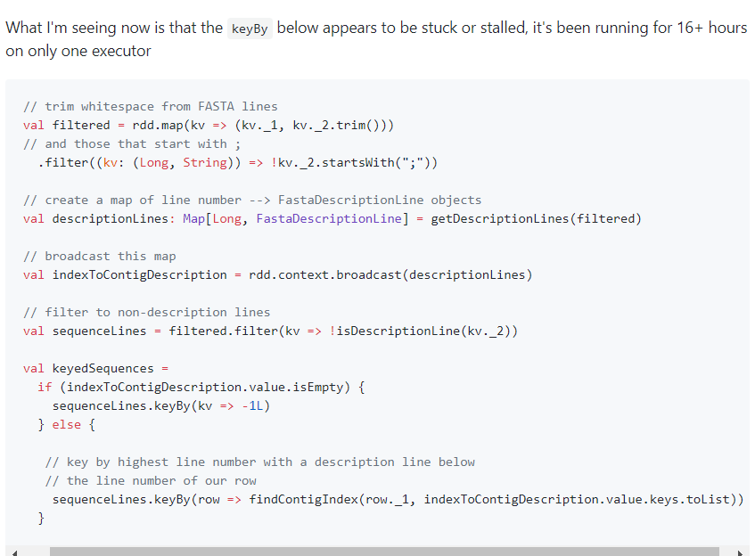
Abstract
Pipeline and Platform
Algorithm and Key issue
Accomplish and future work
Key issues
Our journey
01
Data pick
So we started with the FASTA file which provided by the SuperNova 2.1.0.
The FASTA file is only about 10G because it was sequenced by SuperNova in some terms.
Fastatoadam
Fastatoadam in ADAM on cluster failed.
We checked the source code of ADAM and found that it uses RDD keyby, which may cause the problem to deal with the file larger than 10G (resource Source code rdd groupby)
https://github.com/bigdatagenomics/adam/issues/1891
02

Slide 13

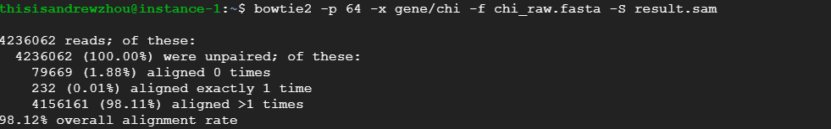
Abstract
Pipeline and Platform
Algorithm and Key issue
Accomplish and future work
Key issue
03
At first we use the 10g fasta to test the feasibility of this pipeline.
We setup a 64 CPUs 400g RAM machine on GCP to working on the process.
By using standalone version of bowtie2, we get a result of sequence which has 98.12$ aligned rate
Bowtie2

Slide 14
0 4
Accomplish and future work
PART FOUR

Slide 15
Abstract
Pipeline and Platform
Algorithm and Key issue
Accomplish and future work
Accomplishment
roadmap
Fasta to sam
Build a pipeline for transform the data.
We use bowtie2 to align 10g fasta to aligned-sam file
01
02
03
04
setup
Next step
Implement a spark-built palatiform adam on EMR clusters
Transform 160g fastqs by our pipline.

Slide 16
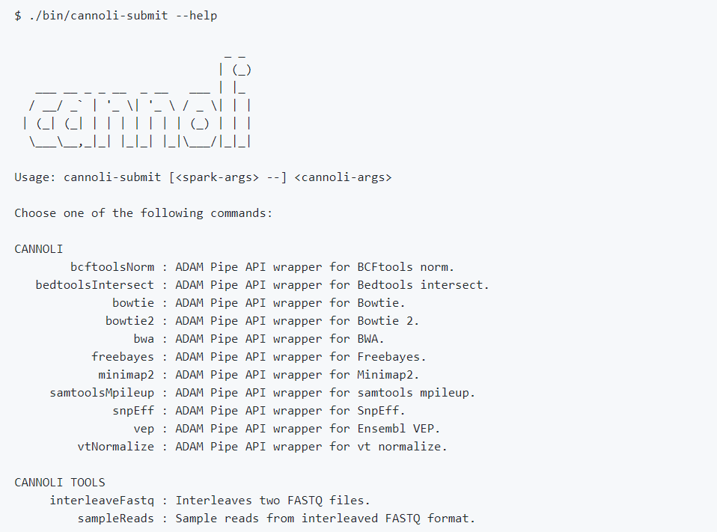
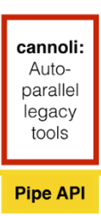
Abstract
Pipeline and Platform
Algorithm and Key issue
Accomplish and future work
Feature work
Future to work
160g
fastqs
Notes:
Cannoli - ADAM Pipe API wrappers for bioinformatics tools, (e.g., BWA, bowtie2, FreeBayes)

Slide 18
THANK YOU FOR WATCHING

